Slide 1
Genesis 4.1-15
God
Spiritual
Blessing
Trust
?
?
?
?
?
?
Submit / Obey
Depend / Trust
?
?
?
YOU
Physical Blessing
Go Your Own Way

Slide 2
God
Genesis 4.1 NIV: Adam made love to his wife Eve, and she became pregnant and gave birth to Cain. She said, “With the help of the LORD [Yahweh]
I have brought forth a man.”
קַ֫יִן = Cain
קָנִ֥יתִי אִ֖ישׁ = I have created a man
Man
Family
Creation

Slide 3
Genesis 4.1: Then she said,
1: I have created a man just as did Yahweh [NET]
2: I have created a man with help from Yahweh [NIV; NLT; CSB]
3: I have acquired a man with help from Yahweh [NASB; ESV; NKJV]
4: I have created a man who is Yahweh
she bore אֶת־קַ֔יִן; she has created a man אֶת־יְהוָֽה

Slide 4
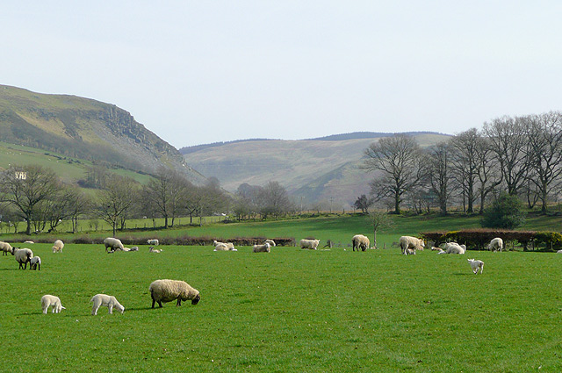
Genesis 4.2 NIV: Later she gave birth to his brother Abel. Now Abel kept flocks, and Cain worked the soil.
Photo by Roger Kidd; wikimedia.org

Slide 5
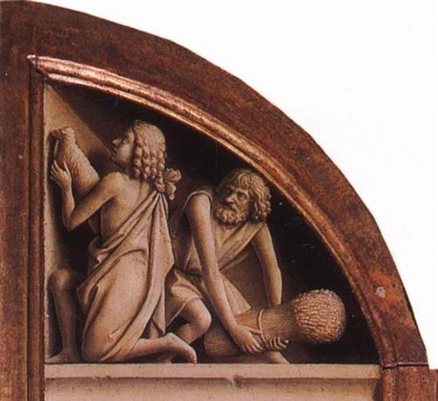
Genesis 4.3-5 NIV: In the course of time Cain brought some of the fruits of the soil as an offering to the LORD. And Abel also brought an offering— fat portions from some of the firstborn of his flock. The LORD looked with favor on Abel and his offering, but on Cain and his offering he did not look with favor. So Cain was very angry, and his face was downcast.
Jan van Eyck
St. Bavo Cathedral
Ghent, Belgium
wikiart.org

Slide 6
Hebrews 11.4 NIV: By faith Abel brought God a better offering than Cain did. By faith he was commended as righteous, when God spoke well of his offerings.
Genesis 4.3-5 NIV: In the course of time Cain brought some of the fruits of the soil as an offering to the LORD. And Abel also brought an offering— fat portions from some of the firstborn of his flock. The LORD looked with favor on Abel and his offering, but on Cain and his offering he did not look with favor. So Cain was very angry, and his face was downcast.

Slide 7
1 John 3.12 NIV: …his [Cain’s] own actions were evil and his brother’s were righteous.
Genesis 4.3-5 NIV: In the course of time Cain brought some of the fruits of the soil as an offering to the LORD. And Abel also brought an offering— fat portions from some of the firstborn of his flock. The LORD looked with favor on Abel and his offering, but on Cain and his offering he did not look with favor. So Cain was very angry, and his face was downcast.

Slide 8
Abel acted righteously [1 John 3] by offering a greater sacrifice of an animal [Genesis 3-4], because he was acting in faith [Hebrews 11] in the promise of a savior, that animal sacrifices were a symbolic and temporary solution for God’s wrath about sin until the savior came.

Slide 9
Genesis 4.6-7 NIV: Then the LORD said to Cain, “Why are you angry? Why is your face downcast? If you do what is right, will you not be accepted? But if you do not do what is right, sin is crouching at your door; it desires to have you, but you must rule over it.”
God
Spiritual
Blessing
Trust
?
?
?
?
?
?
Submit / Obey
Depend / Trust
?
?
?
YOU
Physical Blessing
Go Your Own Way

Slide 10
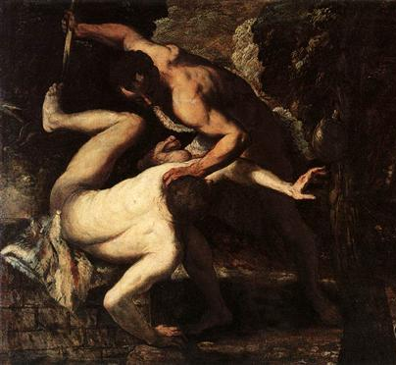
Genesis 4.8-9 NIV: Now Cain said to his brother Abel, “Let’s go out to the field.” While they were in the field, Cain attacked his brother Abel and killed him.
Then the LORD said to Cain, “Where is your brother Abel?” I don’t know,” he replied. “Am I my brother’s keeper?”
Tintoretto; Gallerie dell’Accademia; Venice, Italy

Slide 11
1 John 3.11-12 NIV: For this is the message you heard from the beginning: We should love one another. Do not be like Cain, who belonged to the evil one and murdered his brother. And why did he murder him? Because his own actions were evil and his brother’s were righteous.
Genesis 4.8-9 NIV: Now Cain said to his brother Abel, “Let’s go out to the field.” While they were in the field, Cain attacked his brother Abel and killed him. Then the LORD said to Cain, “Where is your brother Abel?” I don’t know,” he replied. “Am I my brother’s keeper?”

Slide 12
1 John 3.13 NIV: Do not be surprised, my brothers and sisters, if the world hates you.
Genesis 4.8-9 NIV: Now Cain said to his brother Abel, “Let’s go out to the field.” While they were in the field, Cain attacked his brother Abel and killed him. Then the LORD said to Cain, “Where is your brother Abel?” I don’t know,” he replied. “Am I my brother’s keeper?”

Slide 13
Genesis 4.10-12 NIV: The LORD said, “What have you done? Listen! Your brother’s blood cries out to me from the ground.
Now you are under a curse and driven from the ground, which opened its mouth to receive your brother’s blood from your hand.
When you work the ground, it will no longer yield its crops for you.
You will be a restless wanderer on the earth.”

Slide 14
Genesis 4.13-15 NIV: Cain said to the LORD, “My punishment is more than I can bear. Today you are driving me from the land, and I will be hidden from your presence; I will be a restless wanderer on the earth, and whoever finds me will kill me.” But the LORD said to him, “Not so; anyone who kills Cain will suffer vengeance seven times over.” Then the LORD put a mark on Cain so that no one who found him would kill him.

Slide 15
God
God
Spiritual
Blessing
Trust
Family
Man
?
?
?
?
?
?
Submit / Obey
Depend / Trust
?
Creation
?
?
YOU
Physical Blessing
Make YOUR own choices

Slide 16
God
God
Spiritual
Blessing
Trust
God’s Solution
Repentant Confession
Animal Sacrifice
Promise of a Savior
Family
Man
?
?
?
Submit / Obey
Depend / Trust
?
Creation
?
?
YOU
Physical Blessing
Make YOUR own choices

Slide 17
God
Spiritual
Blessing
?
God’s Solution
Repentant Confession
Animal Sacrifice
Promise of a Savior
?
?
Trust & Obey God’s Revelation
?
?
?
YOU
Physical Blessing
Act Apart from Revelation

